Slide 1
PAWS
September 29th

Slide 2
Events
Zoo Boo
Available times:
7:45am-12:30pm
10:45am-4:15pm.
We don’t have a set date yet, but we’ll send out an email as soon as we do.
Houston SPCA Tour
November 19th @ 12pm – Houston SPCA tour (our November event)

Slide 3
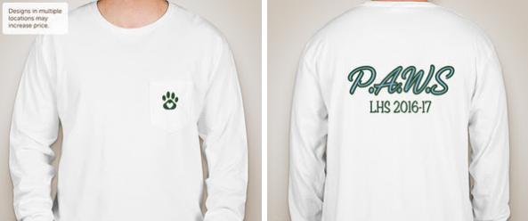
Club t-Shirts
This is the shirt that was voted on during our last meeting! You can order a shirt on our website.

Slide 4
Changing meeting date
We will still be having PAWS meetings every other Thursday, but due to Mr. Milum’s other club (the Harry Potter Club) meeting on A day Thursdays, we have to change to B day Thursdays.
What’s going to happen: we’re NOT going to have a meeting two weeks from now. Instead, our next meeting will be October 6th, a B day Thursday. We will send out email reminders of this change.

Slide 5
New members form and remind101
To those of you who haven’t, please fill out a New Members Form on our website lamarpaws.weebly.com. Filling this out will help us add you to the email list and have a count of who’s in our club.
The New Members Form is under the ‘Updates’ tab.
If you would like to join out Lamar PAWS Remind 101, text @lhspaws to 81010. We will be sending reminders of meetings, events, and other important notices.

