Slide 1
November 10th

Slide 2
Houston spca tour
We are going to the Houston SPCA on November 19th from 12-1pm for a tour of their facilities to see how shelters work.
We have a limited number of spots for people to go, but there is still room for a few more. You can sign up to go on the website.
PLEASE be sure to go if you signed up. You will get another reminder for this event.
Address: 900 Portway Dr., Houston, TX 77024

Slide 3
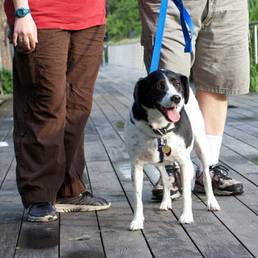
Iwalk for animals
Would we like to participate in this event?
“Fetch your sneakers, a furry friend and join the Houston SPCA for some fun at the 2016 iWalk for Animals on Saturday, December 3 at Memorial Park - Picnic Loop from 8 a.m. to 11:30 a.m. There will be a 5K Canine Caper that begins at 9:15 a.m. and a 1K Pup Strut that begins at 9:30 a.m. You don't want to miss exciting demonstrations, live music and amazing vendors. And, of course, participate in everyone's favorite pet-related contests like Best Kisser, Best Costume and Pet Owner Look Alike.”

Slide 4
Buster Buddies
We can start participating with Buster Buddies on December 3rd. We will have signups for this soon on the website, and you will get a reminder regarding this volunteering opportunity.

Slide 5
T-SHIRTS AND DUES MONEY
713-818-0253
713-816-4371

